Slide 1
Lecture 6:
Training Neural Networks,
Part 2

Slide 2
Administrative
A2 is out. It’s meaty. It’s due Feb 5 (next Friday)
You’ll implement:
Neural Nets (with Layer Forward/Backward API)
Batch Norm
Dropout
ConvNets

Slide 3

Mini-batch SGD
Loop:
Sample a batch of data
Forward prop it through the graph, get loss
Backprop to calculate the gradients
Update the parameters using the gradient

Slide 4
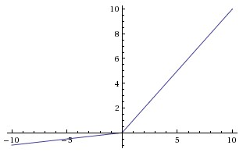
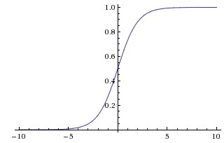
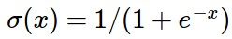
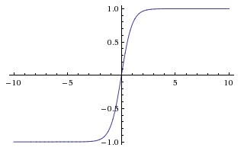
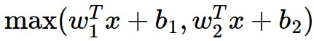
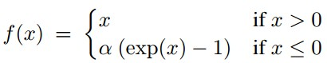
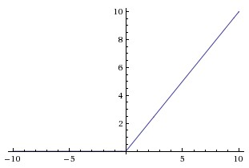
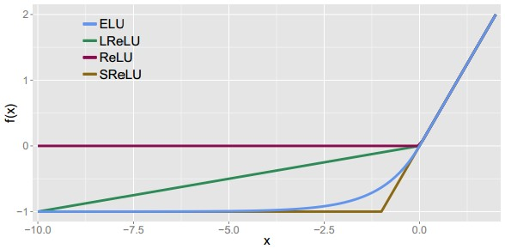
Activation Functions
Leaky ReLU
max(0.1x, x)
Sigmoid
Maxout
tanh tanh(x)
ELU
ReLU max(0,x)

Slide 5
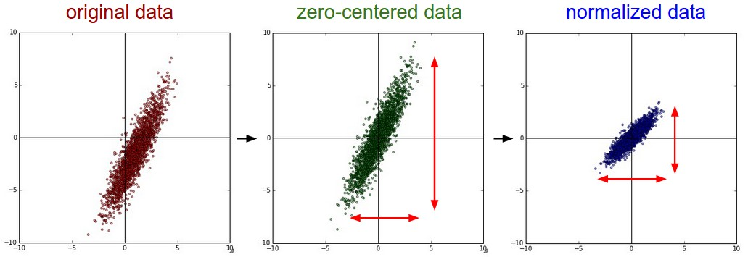
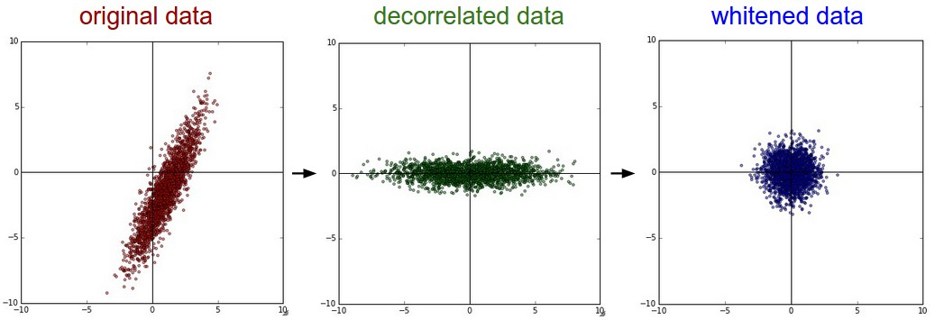
Data
Preprocessing

Slide 6
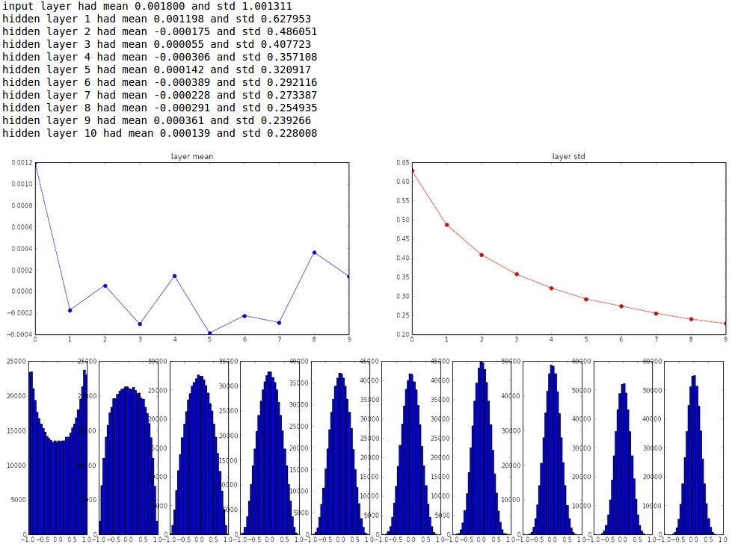
“Xavier initialization”
[Glorot et al., 2010]
Reasonable initialization.
(Mathematical derivation assumes linear activations)
Weight Initialization

Slide 7
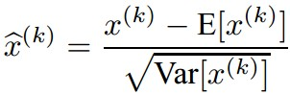
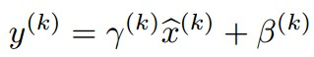
Batch Normalization
[Ioffe and Szegedy, 2015]
Improves gradient flow through the network
Allows higher learning rates
Reduces the strong dependence on initialization
Acts as a form of regularization in a funny way, and slightly reduces the need for dropout, maybe
Normalize:
And then allow the network to squash
the range if it wants to:

Slide 8
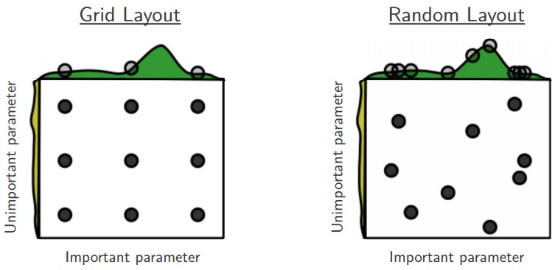
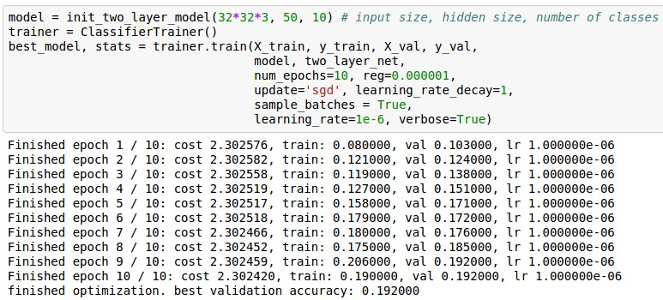
Babysitting the learning process
Cross-validation
Loss barely changing: Learning rate is probably too low

Slide 9
TODO
Parameter update schemes
Learning rate schedules
Dropout
Gradient checking
Model ensembles

Slide 10
Parameter Updates

Slide 11
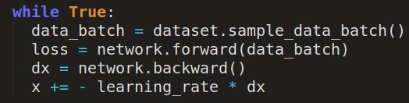
Training a neural network, main loop:

Slide 12
Training a neural network, main loop:
simple gradient descent update
now: complicate.

Slide 13
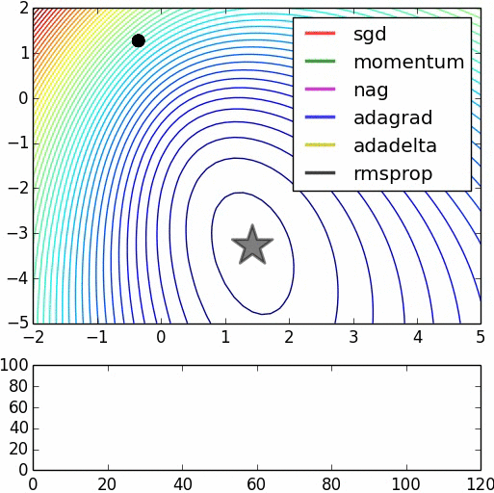
Image credits: Alec Radford

Slide 14
Suppose loss function is steep vertically but shallow horizontally:
Q: What is the trajectory along which we converge towards the minimum with SGD?

Slide 15
Suppose loss function is steep vertically but shallow horizontally:
Q: What is the trajectory along which we converge towards the minimum with SGD?

Slide 16
Suppose loss function is steep vertically but shallow horizontally:
Q: What is the trajectory along which we converge towards the minimum with SGD? very slow progress along flat direction, jitter along steep one

Slide 17
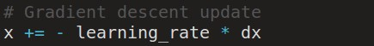
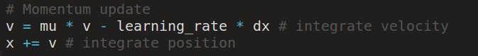
Momentum update
- Physical interpretation as ball rolling down the loss function + friction (mu coefficient).
- mu = usually ~0.5, 0.9, or 0.99 (Sometimes annealed over time, e.g. from 0.5 -> 0.99)

Slide 18
Momentum update
Allows a velocity to “build up” along shallow directions
Velocity becomes damped in steep direction due to quickly changing sign

Slide 19
SGD
vs
Momentum
notice momentum
overshooting the target, but overall getting to the minimum much faster.

Slide 20
Nesterov Momentum update
Ordinary momentum update:
momentum
step
actual step
gradient
step

Slide 21
Nesterov Momentum update
Momentum update
Nesterov momentum update
“lookahead” gradient step (bit different than original)
momentum
step
momentum
step
actual step
actual step
gradient
step

Slide 22
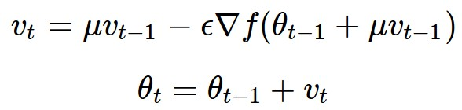
Nesterov Momentum update
Momentum update
Nesterov momentum update
“lookahead” gradient step (bit different than original)
momentum
step
momentum
step
actual step
actual step
gradient
step
Nesterov: the only difference...

Slide 23
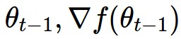
Nesterov Momentum update
Slightly inconvenient…
usually we have :

Slide 24
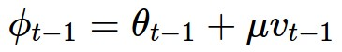
Nesterov Momentum update
Slightly inconvenient…
usually we have :
Variable transform and rearranging saves the day:

Slide 25
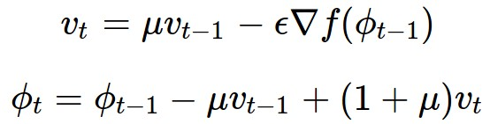
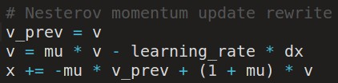
Nesterov Momentum update
Slightly inconvenient…
usually we have :
Variable transform and rearranging saves the day:
Replace all thetas with phis, rearrange and obtain:

Slide 26
nag =
Nesterov Accelerated Gradient

Slide 27
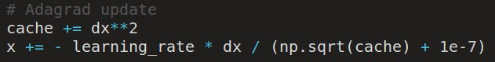
AdaGrad update
[Duchi et al., 2011]
Added element-wise scaling of the gradient based on the historical sum of squares in each dimension

Slide 28
AdaGrad update
Q: What happens with AdaGrad?

Slide 29
AdaGrad update
Q2: What happens to the step size over long time?

Slide 30
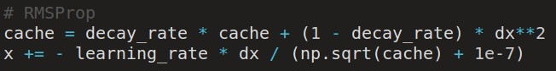
RMSProp update
[Tieleman and Hinton, 2012]

Slide 31
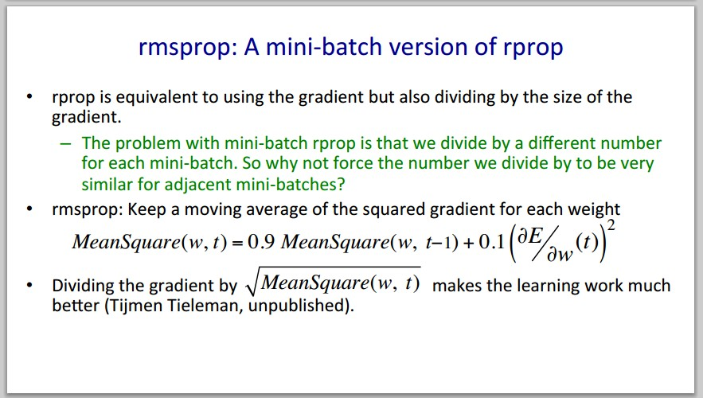
Introduced in a slide in Geoff Hinton’s Coursera class, lecture 6

Slide 32
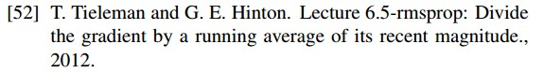
Introduced in a slide in Geoff Hinton’s Coursera class, lecture 6
Cited by several papers as:

Slide 33
adagrad
rmsprop

Slide 34
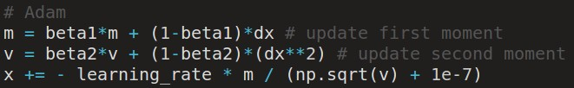
Adam update
[Kingma and Ba, 2014]
(incomplete, but close)

Slide 35
Adam update
[Kingma and Ba, 2014]
(incomplete, but close)
momentum
RMSProp-like
Looks a bit like RMSProp with momentum

Slide 36
Adam update
[Kingma and Ba, 2014]
(incomplete, but close)
momentum
RMSProp-like
Looks a bit like RMSProp with momentum

Slide 37
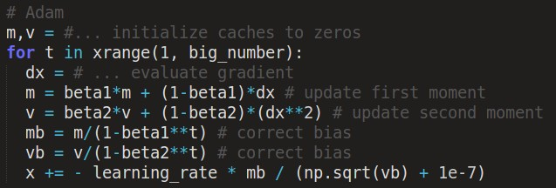
Adam update
[Kingma and Ba, 2014]
momentum
bias correction
(only relevant in first few iterations when t is small)
RMSProp-like
The bias correction compensates for the fact that m,v are initialized at zero and need some time to “warm up”.

Slide 38

SGD, SGD+Momentum, Adagrad, RMSProp, Adam all have learning rate as a hyperparameter.
Q: Which one of these learning rates is best to use?

Slide 39
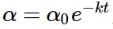
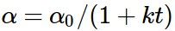
SGD, SGD+Momentum, Adagrad, RMSProp, Adam all have learning rate as a hyperparameter.
=> Learning rate decay over time!
step decay:
e.g. decay learning rate by half every few epochs.
exponential decay:
1/t decay:

Slide 40
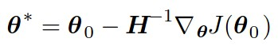
Second order optimization methods
second-order Taylor expansion:
Solving for the critical point we obtain the Newton parameter update:
Q: what is nice about this update?

Slide 41
Second order optimization methods
second-order Taylor expansion:
Solving for the critical point we obtain the Newton parameter update:
notice:
no hyperparameters! (e.g. learning rate)
Q2: why is this impractical for training Deep Neural Nets?

Slide 42
Second order optimization methods
Quasi-Newton methods (BGFS most popular):
instead of inverting the Hessian (O(n^3)), approximate inverse Hessian with rank 1 updates over time (O(n^2) each).
L-BFGS (Limited memory BFGS):
Does not form/store the full inverse Hessian.

Slide 43
L-BFGS
Usually works very well in full batch, deterministic mode
i.e. if you have a single, deterministic f(x) then L-BFGS will probably work very nicely
Does not transfer very well to mini-batch setting. Gives bad results. Adapting L-BFGS to large-scale, stochastic setting is an active area of research.

Slide 44
In practice:
Adam is a good default choice in most cases
If you can afford to do full batch updates then try out L-BFGS (and don’t forget to disable all sources of noise)

Slide 45
Evaluation:
Model Ensembles

Slide 46
Train multiple independent models
At test time average their results
Enjoy 2% extra performance

Slide 47
Fun Tips/Tricks:
can also get a small boost from averaging multiple model checkpoints of a single model.

Slide 48
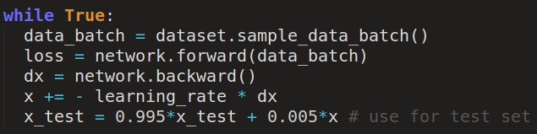
Fun Tips/Tricks:
can also get a small boost from averaging multiple model checkpoints of a single model.
keep track of (and use at test time) a running average
parameter vector:

Slide 49
Regularization (dropout)

Slide 50
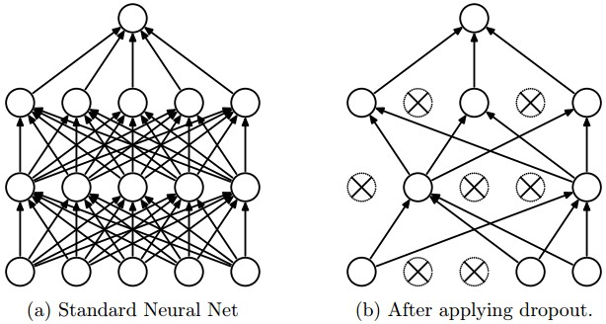
Regularization: Dropout
“randomly set some neurons to zero in the forward pass”
[Srivastava et al., 2014]

Slide 51
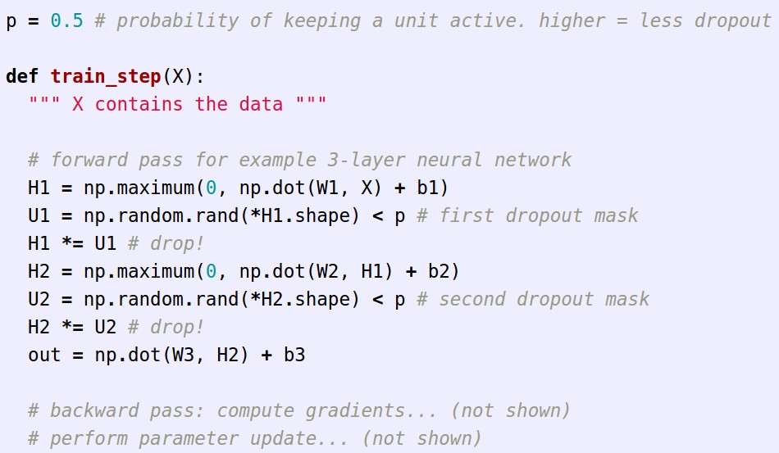
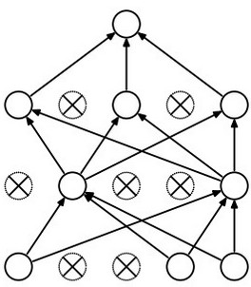
Example forward pass with a 3-layer network using dropout

Slide 52
Waaaait a second…
How could this possibly be a good idea?

Slide 53
Waaaait a second…
How could this possibly be a good idea?
Forces the network to have a redundant representation.
has an ear
X
has a tail
is furry
X
cat
score
has claws
X
mischievous
look

Slide 54
Waaaait a second…
How could this possibly be a good idea?
Another interpretation:
Dropout is training a large ensemble of models (that share parameters).
Each binary mask is one model, gets trained on only ~one datapoint.

Slide 55
At test time….
Ideally:
want to integrate out all the noise
Monte Carlo approximation:
do many forward passes with different dropout masks, average all predictions

Slide 56
At test time….
Can in fact do this with a single forward pass! (approximately)
Leave all input neurons turned on (no dropout).
(this can be shown to be an approximation to evaluating the whole ensemble)

Slide 57
At test time….
Can in fact do this with a single forward pass! (approximately)
Leave all input neurons turned on (no dropout).
Q: Suppose that with all inputs present at test time the output of this neuron is x.
What would its output be during training time, in expectation? (e.g. if p = 0.5)

Slide 58
At test time….
Can in fact do this with a single forward pass! (approximately)
Leave all input neurons turned on (no dropout).
during test: a = w0*x + w1*y
during train:
E[a] = ¼ * (w0*0 + w1*0
w0*0 + w1*y
w0*x + w1*0
w0*x + w1*y)
= ¼ * (2 w0*x + 2 w1*y)
= ½ * (w0*x + w1*y)
a
w1
w0
x
y

Slide 59
At test time….
Can in fact do this with a single forward pass! (approximately)
Leave all input neurons turned on (no dropout).
during test: a = w0*x + w1*y
during train:
E[a] = ¼ * (w0*0 + w1*0
w0*0 + w1*y
w0*x + w1*0
w0*x + w1*y)
= ¼ * (2 w0*x + 2 w1*y)
= ½ * (w0*x + w1*y)
With p=0.5, using all inputs in the forward pass would inflate the activations by 2x from what the network was “used to” during training!
=> Have to compensate by scaling the activations back down by ½
a
w1
w0
x
y

Slide 60
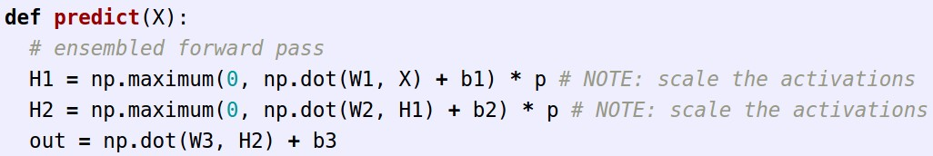
We can do something approximate analytically
At test time all neurons are active always
=> We must scale the activations so that for each neuron:
output at test time = expected output at training time

Slide 61
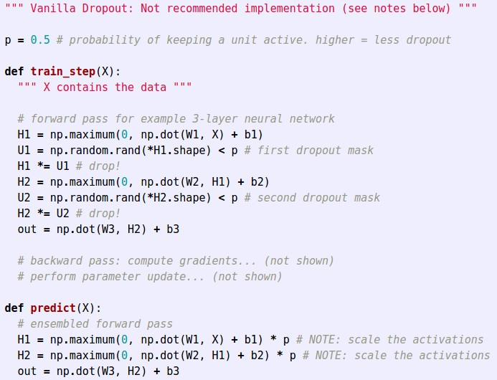
Dropout Summary
drop in forward pass
scale at test time

Slide 62
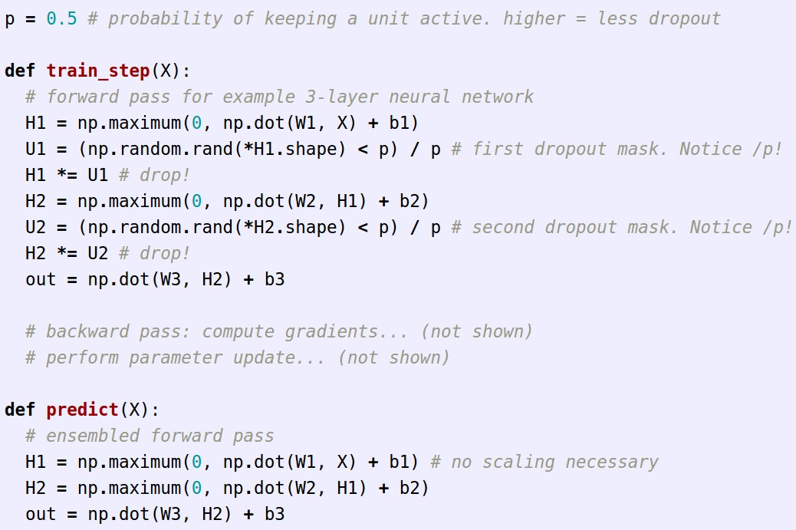
More common: “Inverted dropout”
test time is unchanged!

Slide 63
<fun story time>
(Deep Learning Summer School 2012)

Slide 64
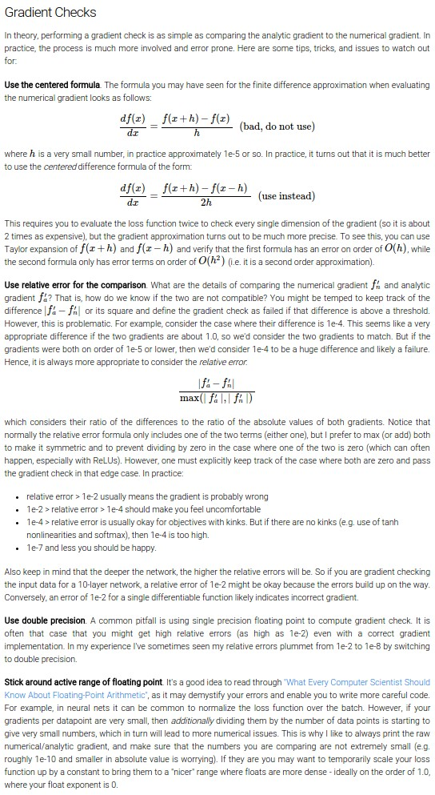
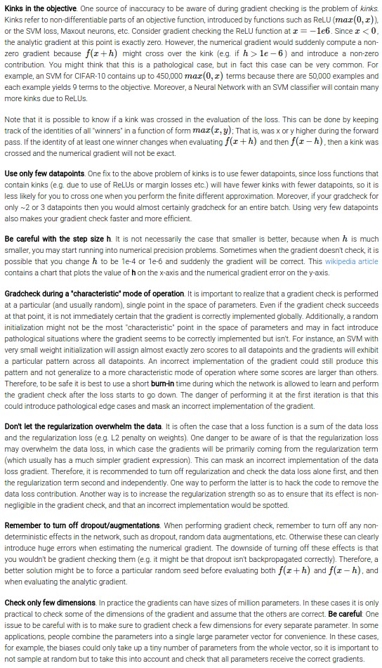
Gradient Checking
(see class notes...)
fun guaranteed.

Slide 65

Convolutional Neural Networks
[LeNet-5, LeCun 1980]

Slide 66
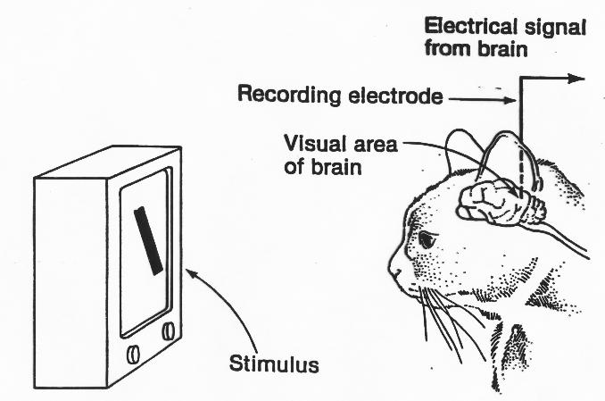
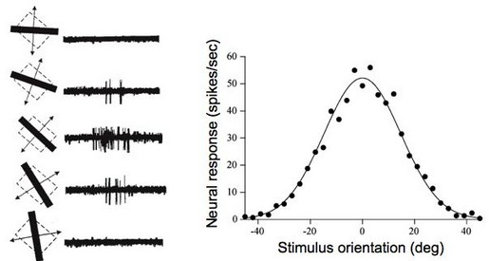
A bit of history:
Hubel & Wiesel,
1959
RECEPTIVE FIELDS OF SINGLE NEURONES IN
THE CAT'S STRIATE CORTEX
1962
RECEPTIVE FIELDS, BINOCULAR INTERACTION
AND FUNCTIONAL ARCHITECTURE IN
THE CAT'S VISUAL CORTEX
1968...

Slide 67
Video time https://youtu.be/8VdFf3egwfg?t=1m10s

Slide 68
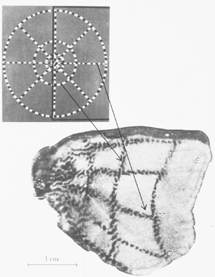
A bit of history
Topographical mapping in the cortex:
nearby cells in cortex represented
nearby regions in the visual field

Slide 69
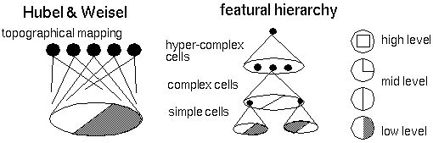
Hierarchical organization

Slide 70
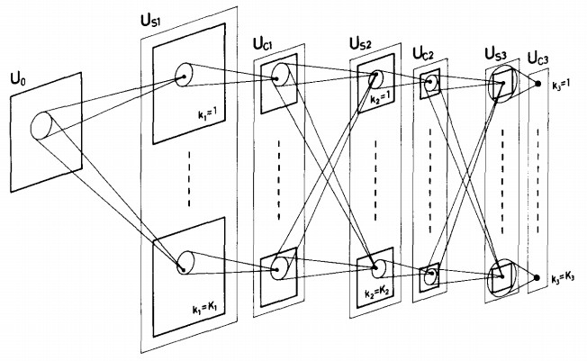
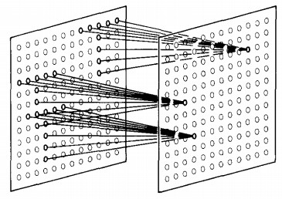
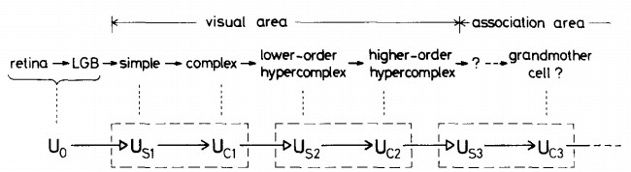
“sandwich” architecture (SCSCSC…)
simple cells: modifiable parameters
complex cells: perform pooling
A bit of history:
Neurocognitron
[Fukushima 1980]

Slide 71
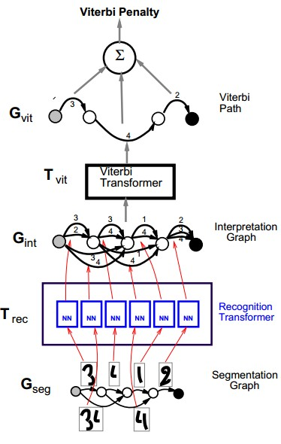
A bit of history:
Gradient-based learning applied to document recognition
[LeCun, Bottou, Bengio, Haffner 1998]
LeNet-5

Slide 72


A bit of history:
ImageNet Classification with Deep Convolutional Neural Networks
[Krizhevsky, Sutskever, Hinton, 2012]
“AlexNet”

Slide 73

Fast-forward to today: ConvNets are everywhere
Classification
Retrieval
[Krizhevsky 2012]

Slide 74


Fast-forward to today: ConvNets are everywhere
Detection
Segmentation
[Faster R-CNN: Ren, He, Girshick, Sun 2015]
[Farabet et al., 2012]

Slide 75


Fast-forward to today: ConvNets are everywhere
NVIDIA Tegra X1
self-driving cars

Slide 76



Fast-forward to today: ConvNets are everywhere
[Taigman et al. 2014]
[Goodfellow 2014]
[Simonyan et al. 2014]

Slide 77


Fast-forward to today: ConvNets are everywhere
[Toshev, Szegedy 2014]
[Mnih 2013]

Slide 78



Fast-forward to today: ConvNets are everywhere
[Ciresan et al. 2013]
[Sermanet et al. 2011]
[Ciresan et al.]

Slide 79




Fast-forward to today: ConvNets are everywhere
[Denil et al. 2014]
[Turaga et al., 2010]

Slide 80


Whale recognition, Kaggle Challenge
Mnih and Hinton, 2010

Slide 81

Image Captioning
[Vinyals et al., 2015]

Slide 82




reddit.com/r/deepdream

Slide 83


Slide 84

Deep Neural Networks Rival the Representation of Primate IT Cortex for Core Visual Object Recognition
[Cadieu et al., 2014]

Slide 85


Deep Neural Networks Rival the Representation of Primate IT Cortex for Core Visual Object Recognition
[Cadieu et al., 2014]

Slide 86


